Slide 1


Top Songs from 2018-2019, 2020, and Random songs from my playlist
Hemin Patel
Data 101

Slide 2
Idea & Dataset
For my first Data 101 HW, I chose my project about Spotify and the top songs from 2010-2019. So I thought it would be a fantastic choice for my final project to see what I can predict now as I know more. However, I realized in one of the examples, a student used the same dataset link I used in the past. However, as I still want to pursue this idea, I created my own dataset consisting of the Top 50 songs from 2018 and 2019. Moreover, I created a dataset consisting of Top 50 songs from 2020 and random 50 songs from my own playlist.
Kaggle Top 2018-2019 Dataset Link
Kaggle Top 2020 Dataset Link
Kaggle Random Songs From My Playlist Dataset Link (kept this one as a private dataset)
Data 101

Slide 3
Attributes
BPM – Beats Per Minute - The tempo of the song.
Energy - The energy of a song; the higher the value, the more energetic.
Danceability – Describes how suitable a track is for dancing; the higher the value, the easier it is to dance.
Loudness (dB) – The loudness level in decibels, higher the value, the louder the song
Valence - A measure of musical positiveness of the track. The tracks with the highest number give a sense of positive moods.
Duration (sec) - The duration of the song in seconds.
Acousticness - A measure of how acoustic the track is.
Speechiness - The higher the value that tells how many spoken words were in the track.
Popularity - The higher the value, the more popular the song is.
Data 101

Slide 4
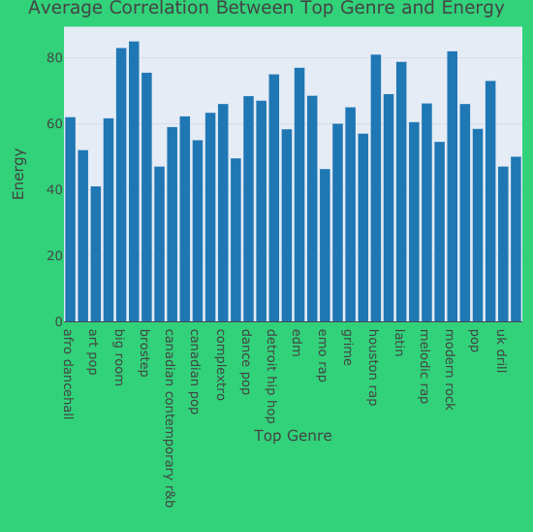
Top Genre v. Energy
In this graph, I measured Top Genre and Energy in the years of 2018 and 2019. The popular genre is Boy Band which has an average Energy of 85.
Data 101
Notes:
# Top Genre vs Energy
library(plotly)
aggregate(nrgy ~ top.genre, data = top18_19, FUN= mean)
k <- aggregate(nrgy ~ top.genre, data = top18_19, FUN= mean)
write.csv(k,'~/Desktop/Data 101/Final Project/18_19AggregateData.csv')
agg_18_19 <- read.csv("~/Desktop/Data 101/Final Project/18_19AggregateData.csv")
# Energy18_19 <- agg_18_19$nrgy
attach(agg_18_19)
fig <- plot_ly(x = c(top.genre), y = c(nrgy), width = 500, height = 500, type = 'bar')%>%
layout(title= list(text = "Average Correlation Between Top Genre and Energy",font = "Times New Roman"), font="Times New Roman",
xaxis = list(title = list(text ='Top Genre', font = "Times New Roman")),
yaxis = list(title = list(text ='Energy', font = "Times New Roman")),
plot_bgcolor='#e5ecf6', paper_bgcolor='#31d27a')
fig

Slide 5
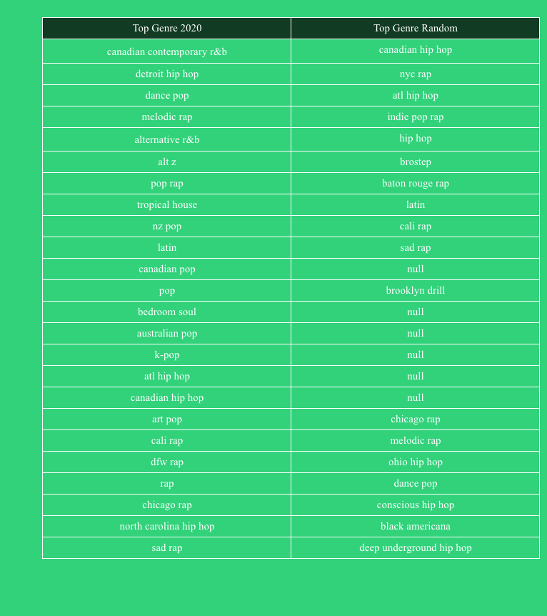
Popular Genres
For this chart, I compared the Top Genres for the 2020 dataset, and the Random songs I picked from my playlist.
I was trying to see the correlation between these two dataset. Sadly, after testing, I realized the genres did not match up.
However, that's how data is, and it shows how the songs in my playlist aren't the same genre as the Top 2020 songs. Although other attributes might closely relate, where the genre failed.
Data 101
Notes:
Mix1 <- subset(top20[,c(1,4)])
Mix2 <- subset(Random[,c(1,4)])
library(dplyr)
Distinct2020 <- distinct(Mix1, top.genre)
DistinctRandom <- distinct(Mix2, top.genre)
names(DistinctRandom)[1] <- "top.genre2"
Mixed <- merge(data.frame(Distinct2020, row.names=NULL), data.frame(DistinctRandom, row.names=NULL), by = 0, all = TRUE)[-1]
MixedTable <- Mixed %>%
count(top.genre, top.genre2, sort= FALSE)
colnames(Mixed) <- c("Top Genre 2020", "Top Genre Random")
fig <- plot_ly(
type='table',
header=list(
values=names(Mixed),
align = c("center", "center"),
line = list(width = 1, color = 'white'),
fill= list(color= c("#113b22", "#113b22")),
font= list(family = "San Serif", size =15, color = "white"),
height= 30),
cells=list(
values=unname(Mixed),
align = c("center", "center"),
line = list(width = 1, color = 'white'),
fill= list(color= c("#31d27a", "#31d27a")),
font= list(family = "San Serif", size =15, color = "white"),
height= 30)) %>%
layout(paper_bgcolor='#31d27a')
fig

Slide 6
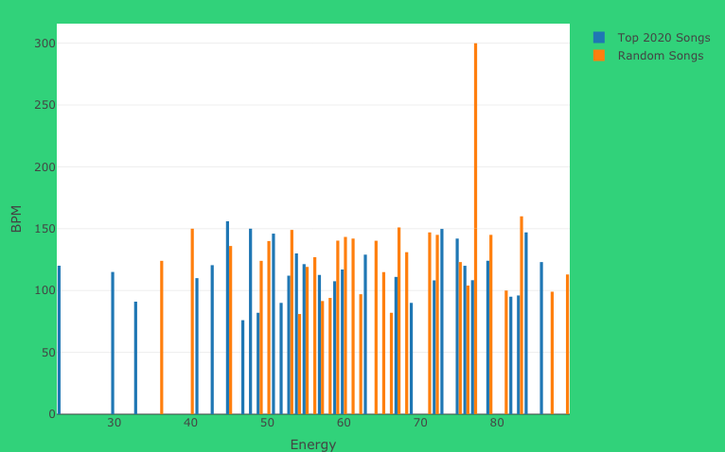
BPM vs. Energy
Since the previous test failed, I decided to test the other attributes.
For this chart, I compared the mean(BPM & Energy) for both 2020 and Random songs.
Looking at this chart, it is apparent that my songs and the Top 2020 songs match closely in these two attributes.
As I mentioned before, even though the genres might be different, they might relate in other ways, and this chart certainly proves that.
Data 101
Notes:
Agg2020 <- aggregate(bpm ~ nrgy, data= top20, FUN= mean)
AggRandom<- aggregate(bpm ~ nrgy, data= Random, FUN= mean)
AggMixed <- merge(data.frame(Agg2020, row.names=NULL), data.frame(AggRandom, row.names=NULL), by = 0, all = TRUE)[-1]
# write.csv(AggMixed, '~/Desktop/Data 101/Final Project/AggMixed.csv')
AggMixed <- read.csv('~/Desktop/Data 101/Final Project/AggMixed.csv')
library(plotly)
fig <- plot_ly(AggMixed, x = ~nrgy.x, y = ~bpm.x, type = 'bar', name = 'Top 2020 Songs')
fig <- fig %>% add_trace(y = ~bpm.y, name = 'Random Songs')
fig <- fig %>% layout(yaxis = list(title = 'BPM'),
xaxis = list(title = list(text ='Energy'),
barmode = 'group'),
paper_bgcolor='#31d27a')
fig

Slide 7
Predictions 1 (Top 2018/2019 & Random)
Since I had a total of three datasets: Top 2018-2019 songs, Top 2020 songs, and Random songs, I wanted to test if the Random songs would fit into the Top song databases.
my.model <- lm(nrgy ~ bpm + dnce + year, data = top18_19)
lm.model.predictions <- predict(my.model, Random) #rmse: 11.9136822
regr.error(lm.model.predictions, Random$nrgy)
The RMSE was lower compared with my previous predictions, so I decided to keep this model.
I ran further tests, and saw that the Energy mean was 60.57. I then selected music titles that had a mean around 59-61 from the Random dataset.
For The Night (feat. Lil Baby & DaBaby)
The Box
Molly Girl
Sanguine Paradise
Hold On
Woah
Aim For The Moon (feat. Quavo)
Data 101
Notes:
#Top 2018/2019 = Test case -> testing on Random
# summary(top18_19)
# I ran this to see what I could include in my prediction test. bpm, energy, and danceability all had high avgs, so I decided those should be a factor
# When running the prediction, the rmse value range around >56, so I decided to add year which dropped the rmse to 11.91.
my.model <- lm(nrgy ~ bpm + dnce + year, data = top18_19)
lm.model.predictions <- predict(my.model, Random) #rmse: 11.9136822
regr.error(lm.model.predictions, Random$nrgy)
View(lm.model.predictions)
# summary(lm.model.predictions)
# Min. 1st Qu. Median Mean 3rd Qu. Max.
# 53.07 57.56 59.75 60.57 62.67 74.93
# According to this data, Random songs with the energy level around 60.57 would typically fit best in Top 2018 and 2019 songs.
# When taking a quick look at the data, it seems there are not many songs around that mean, therefore I will include from 59-61 energy level. (+-1 factor)
library(dplyr)
Prediction1 <- select(Random, title, nrgy) #selecting both Title of song and energy lvl
Prediction1 <- filter(Prediction1, Random$nrgy == "59" | Random$nrgy == "60" | Random$nrgy == "61")
Prediction1 <- arrange(Prediction1, nrgy) #Sorting so energy lvl ascends
# For The Night (feat. Lil Baby & DaBaby) 59
# The Box 59
# Molly Girl 59
# Sanguine Paradise 60
# Hold On 60
# Woah 60
# Aim For The Moon (feat. Quavo) 61

Slide 8
Predictions 2 (Top 2020 & Random)
Since I had a total of three datasets: Top 2018-2019 songs, Top 2020 songs, and Random songs, I wanted to test if the Random songs would fit into the Top song databases.
my.model2 <- lm(nrgy ~ bpm + year, data = top20)
lm.model.predictions2 <- predict(my.model2, Random) #rmse: 11.0448944
regr.error(lm.model.predictions2, Random$nrgy)
The RMSE was lower compared with my previous predictions, so I decided to keep this model.
I ran further tests, and saw that the Energy mean was 61.50. I then selected music titles that had a mean around 59-63 from the Random dataset. (I included a +-2 factor as I took a attribute out for better rmse)
For The Night (feat. Lil Baby & DaBaby)
The Box
Molly Girl
Sanguine Paradise
Hold On
Woah
Aim For The Moon (feat. Quavo)
Leaked
**The song titled “The Box” appeared in Top 2020 Songs
Data 101
Notes:
#Top 2020 = Test case -> testing on Random
my.model2 <- lm(nrgy ~ bpm + year, data = top20)
lm.model.predictions2 <- predict(my.model2, Random) #rmse: 11.0448944
regr.error(lm.model.predictions2, Random$nrgy)
# summary(lm.model.predictions2)
# Min. 1st Qu. Median Mean 3rd Qu. Max.
# 58.97 60.41 61.66 61.50 62.54 63.87
# According to this data, Random songs with the energy level around 61.50 would typically fit best in Top 2020 songs.
# Like in the previous code, I will include a +-2 factor, resulting in songs around 59-63 energy level. (The factor is more as I took a attribute out for better rmse)
library(dplyr)
Prediction2 <- select(Random, title, nrgy) #selecting both Title of song and energy lvl
Prediction2 <- filter(Prediction2, Random$nrgy == "59" | Random$nrgy == "60" | Random$nrgy == "61" | Random$nrgy == "62" | Random$nrgy == "63")
Prediction2 <- arrange(Prediction2, nrgy) #Sorting so energy lvl ascends
# For The Night (feat. Lil Baby & DaBaby) 59
# The Box 59 ** In top 2020 songs
# Molly Girl 59
# Sanguine Paradise 60
# Hold On 60
# Woah 60
# Aim For The Moon (feat. Quavo) 61
# Leaked 62

Slide 9
Predictions for Top 2021
Now its hard to predict if these songs would be included in Spotify's Top 2021 songs, so what I will do is see if the artists appeared in the past Top datasets.
library(stringr)
#Prediction1
sum(str_count(top18_19, "Pop Smoke|DaBaby|Roddy Rich|iann dior|Lil Tjay|Lil Baby|Quavo|Lil Uzi Vert")) #4 -> 4/6= 66.67% # Random Artist listed 4 times in 2018/2019; 4 out of 6 Random predicted songs
#Prediction2
sum(str_count(top20, "Pop Smoke|DaBaby|Roddy Rich|iann dior|Lil Tjay|Lil Baby|Quavo|Lil Uzi Vert")) #3 -> 3/8= 37.5% # Random Artist listed 3 times in 2020; 3 out of 8 Random predicted songs
It does certainly seem possible that these songs might be in the Top 2021 as many of these artist appeared in the past Top Song years. However, it seems that the Random songs from my playlist fit more in the years of 2018 and 2019. Out of the 6 songs that matched the Energy mean from 2018/2019, 4 artist appeared in the Top 2018/2019 Songs.
Data 101
Notes:
library(stringr)
#Prediction1
sum(str_count(top18_19, "Pop Smoke|DaBaby|Roddy Rich|iann dior|Lil Tjay|Lil Baby|Quavo|Lil Uzi Vert")) #4 -> 4/6= 66.67% # Random Artist listed 4 times in 2018/2019; 4 out of 6 Random predicted songs
#Prediction2
sum(str_count(top20, "Pop Smoke|DaBaby|Roddy Rich|iann dior|Lil Tjay|Lil Baby|Quavo|Lil Uzi Vert")) #3 -> 3/8= 37.5% # Random Artist listed 3 times in 2020; 3 out of 8 Random predicted songs

Slide 10
Conclusion
Overall, it is somewhat difficult to predict what music will be a hit. The Random songs from my playlist are well-known, some even released across 2018-2020, however I was surprised to not see them in the list.
One of the songs from the Random dataset did appear in the Top 2020 dataset, which proves that the prediction is accurate. There is also a chance that some of these songs did appear in the entire Top 2018 and Top 2019 dataset, however, I only limited to 50 songs per year for this assignment.
On the whole, this was a fun project to work on. I was excited to work with Spotify data again, as I love music. It is interesting to see how my music taste differs with the rest of the US population, and I plan to do another test once Spotify releases their Top 2021 songs.
Data 101

Slide 11


